Slide 1
Multi-Agent Reinforcement Learning for Autonomous Delivery Bots
By
Shivam Kumar(24210094)
Mithlesh Singla(24210063)

Slide 2
What’s our objective?
To develop a multi-agent reinforcement learning (MARL) system for autonomous delivery bots that has following properties :-
Optimum for efficient delivery i.e. minimize steps, avoid collisions .
Ensure all packages are delivered.

Slide 3

Why we choose it?
A lot of work has done for Multi Agent Vehicle Routing Problems (MAVRP) and Pickup and Delivery Problem (PDP), but recent attention has shifted towards Multi agent Cooperative Pickup and Delivery Problem (MAPDP).
So, Currently a hot field and lot of scope of learning and improvement.

Slide 4
What we do?
We Train 4 agents to pick up and deliver 8 packages in a 10x10 grid-world using Proximal Policy Optimization (PPO) and Generalized Advantage Estimation (GAE).
Integrate Simulation of Urban Mobility (SUMO) to our model.

Slide 5
Baseline
We choose our baseline paper:- “MAPDP: Cooperative Multi-Agent Reinforcement Learning to Solve Pickup and Delivery Problems”
Our Contribution
Momentum-based rewards to encourage consistent movement toward targets (packages or destinations) and improving path efficiency.

Slide 6
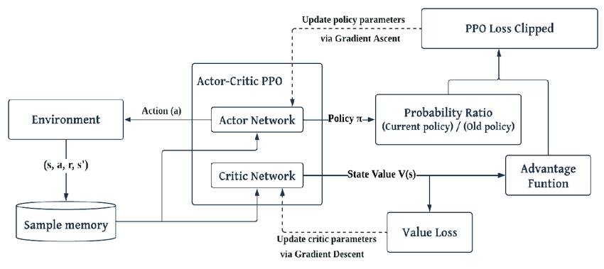
Model Architecture
Use two separate model for Actor and Critic:
Actor estimate policy
Critic estimate value

Slide 7
Data Description
Key Parameters: Grid Size: 10x10
Number of Agents: 4
Number of Packages: 8
Maximum Steps per Episode: 5000
Observation Space Shape:
(49,) (1D tensor per agent)
Components: Agent position (x, y): 2D.
Carrying status: 1D.
Package positions (x, y, status): 3 * 8 = 24D.
Destination positions (x, y): 2 * 8 = 16D.
Other agents’ positions (x, y): 2 * (4-1) = 6D.
Tensor Shape Calculation = 2 + 1 + (3 * 8) + (2 * 8) + (2 * (4 - 1)) =49

Slide 8
Model Tensor Shapes
Actor Network: Input:
(batch_size,49 ) . Layers: Linear(49, 128) → ReLU → Linear(128, 128) → ReLU → Linear(128, 5) → Softmax.
Output: (batch size, 5) (action probabilities).
Critic Network:
Input: (batch size, 49). Layers: Linear(49, 128) → ReLU → Linear(128, 128) → ReLU → Linear(128, 1).
Output: (batch size, 1) (state values).

Slide 9
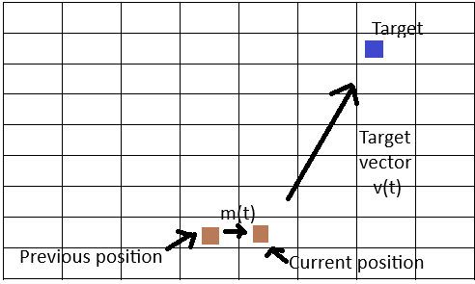
Momentum-Based Reward Calculation
Movement Vector
The agent's movement vector at time step t is:
: current position of the agent
: previous position
For Target Vector
: target (either a package or destination)
: direction vector toward the target

Slide 10

Momentum-Based Reward Calculation
Distance to the target (L1 norm):
Alignment Score: For each direction (x and y): If agent moved toward target → +1 If agent moved away from target → −1 Total alignment ∈ { −1, 1}
Momentum Vector Update:
Momentum is updated with exponential decay:
: decay factor (e.g., γ=0.7)
:current momentum vector
Momentum Magnitude Using Manhattan norm:

Slide 11


Momentum-Based Reward Calculation
Consistency Counter:
Tracks how often the agent moves in the right direction:
Alignment Reward:
Consistency Reward:
Magnitude Reward (only if aligned):

Slide 12


Momentum-Based Reward Calculation
Distance-Based Bonus:
Final Momentum Reward:

Slide 13
Momentum-Based Rewards:
Alignment: +0.05 for moving toward target.
Consistency: Up to +0.25 (0.05 * min(5, consistency count)).
Magnitude: Up to +0.03 (scaled by momentum vector).
Distance: +0.1 when closer to target.
Other Rewards:
Pickup: +2.0
Delivery: +10.0
Collision: -0.1
Step: -0.005
Completion: +25.0

Slide 14
Results

Slide 15
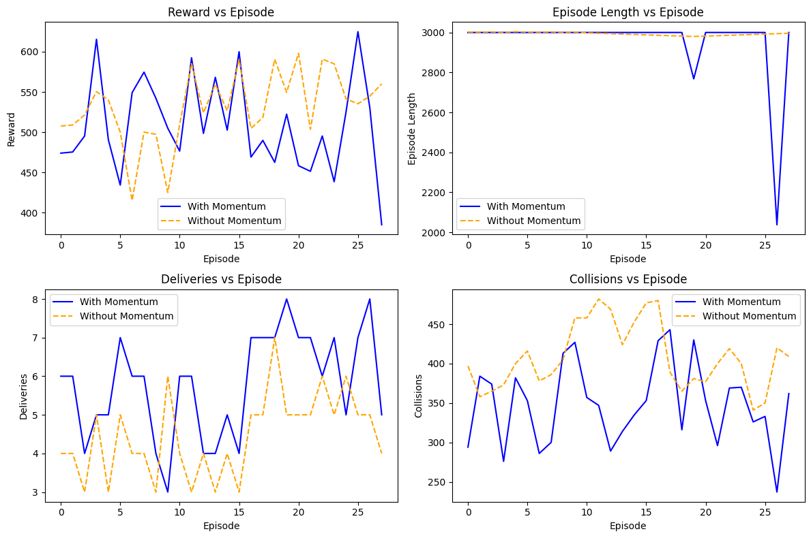
Results with momentum and without momentum

Slide 16
Analysis
Strengths:
The system achieves significant progress (7/8 deliveries), demonstrating effective learning for most tasks.
Collision avoidance appears functional, as agents maintain distinct positions.
Weaknesses:
The failure to deliver the final package suggests policy deficiencies, possibly due to insufficient exploration or suboptimal reward shaping.
The high step count (3000) indicates inefficiency, as agents take too long to complete the task.
Potential Improvements:
Increase exploration.
Adjust rewards to prioritize the final delivery.
Use more complex actor and critic networks.

Slide 17
Conclusion
a multi-agent reinforcement learning system for autonomous delivery bots.
A novel momentum-based reward system enhancing directed movement.

Slide 18
References
Zong, Zefang, et al. "Mapdp: Cooperative multi-agent reinforcement learning to solve pickup and delivery problems." Proceedings of the AAAI Conference on Artificial Intelligence. Vol. 36. No. 9. 2022.
Amato, Christopher. ”An Introduction to Centralized Training for De centralized Execution in Cooperative Multi-Agent Reinforcement Learning.” arXiv e-prints (2024): arXiv-2409.03052. Available at: https: //arxiv.org/abs/2409.03052
Proximal Policy Optimization (PPO) in Reinforcement Learning | GeeksforGeeks
Actor-Critic Algorithm in Reinforcement Learning | GeeksforGeeks

Slide 19
Thank You!

